Slide 1
binary tree
Dr.Priyanka N
Assistant Professor Senior Grade 1
SCOPE
VIT University - Vellore

Slide 2
Convert General tree to binary tree

Slide 3
Rules
The root of the Binary Tree is the Root of the Generic Tree
The left child of a node in the Generic Tree is the Left child of that node in the Binary Tree
The right sibling of any node in the Generic Tree is the Right child of that node in the Binary Tree

Slide 4
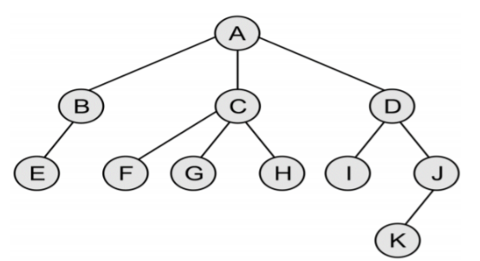
Generic Tree (N-array Tree)

Slide 5
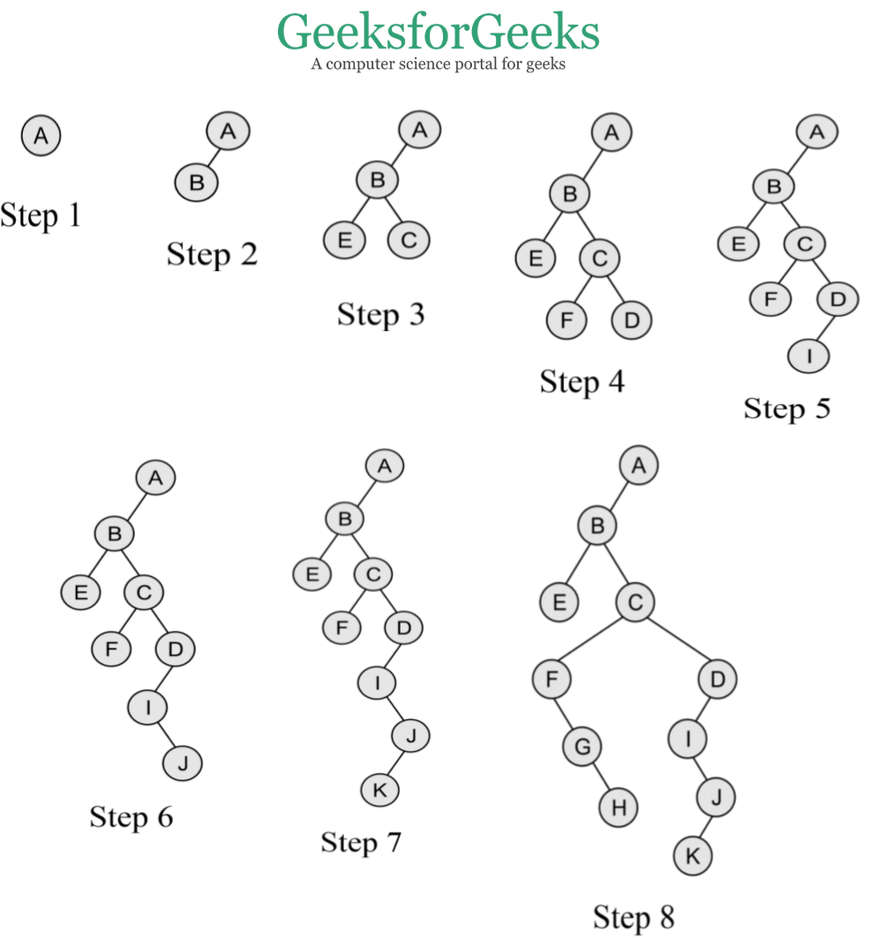
Binary Tree

Slide 6
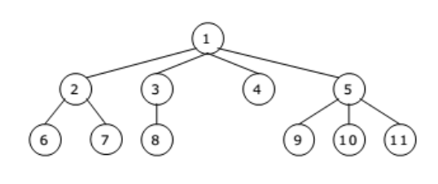
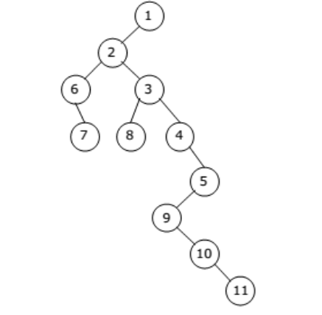
Generic Tree(N-array Tree)
Binary Tree

Slide 7
General tRAVERSALS

Slide 8

RULES
Preorder:
Postorder:

Slide 9
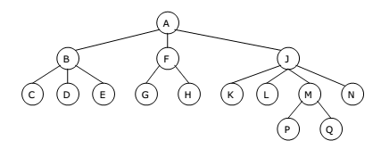
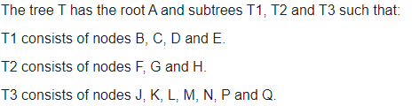
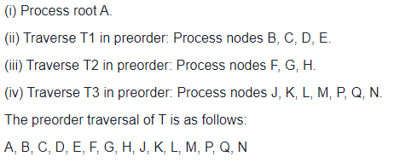
Preorder Traversal
STEPS:
T1
T2
T3

Slide 10
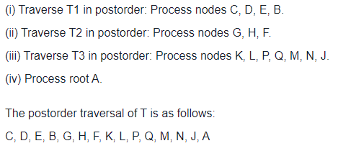
Postorder Traversal
STEPS:
T1
T2
T3

Slide 11
Inorder Traversal
Inorder traversal does not have a natural definition for the general tree, because there is no particular number of children for an internal node
Method 1: Visit the leftmost subtree in inorder, then the root, then visit the remaining subtrees in inorder
Method 2: Visit all the children except the last then the root and finally the last child recursively

Slide 12
ConSTRUCT binary tree FROM PREORDER AND INORDER

Slide 13
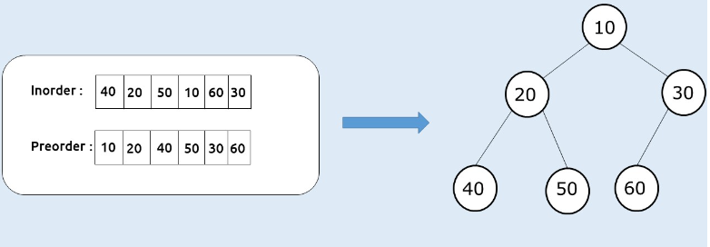
Example:

Slide 14
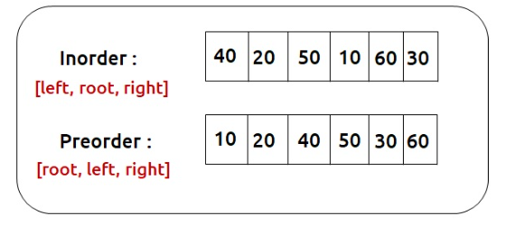
STEPS
Inorder traversal is a special traversal that helps us to identify a node and its left and right subtree
Preorder traversal always gives us the root node as the first element

Slide 15
STEPS
Inorder traversal is a special traversal that helps us to identify a node and its left and right subtree
Preorder traversal always gives us the root node as the first element

Slide 16
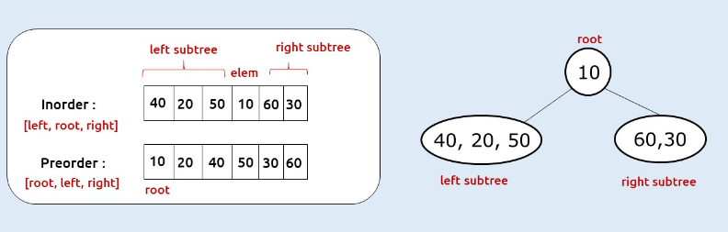
STEPS
10
Inorder
40 | 20 | 50 | 10 | 60 | 30
20
60,30
Preorder
10 | 20 | 40 | 50 | 30 | 60
40
50

Slide 17
STEPS
10
Inorder
40 | 20 | 50 | 10 | 60 | 30
20
30
Preorder
10 | 20 | 40 | 50 | 30 | 60
40
50
60

Slide 18
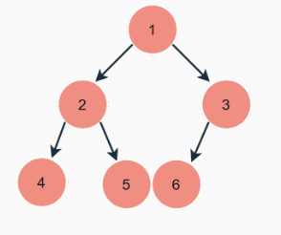
Try it on your own
Inorder
4 | 2 | 5 | 1 | 6 | 3
Preorder
1 | 2 | 4 | 5 | 3 | 6

Slide 19
ConSTRUCT binary tree FROM POSTORDER AND INORDER

Slide 20
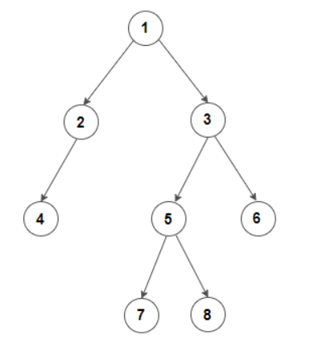
STEPS
Inorder traversal is a special traversal that helps us to identify a node and its left and right subtree
Postorder traversal always gives us the root node as the last element
Inorder
[Left, Root, Right]
4 | 2 | 1 | 7 | 5 | 8 | 3 | 6
Postorder
[Left, Right, Root]
4 | 2 | 7 | 8 | 5 | 6 | 3 | 1

Slide 21
STEPS
[Left subtree]
[Right subtree]
4 | 2 | 1 | 7 | 5 | 8 | 3 | 6
1
Inorder
4,2
7,5,8,3,6
4 | 2 | 7 | 8 | 5 | 6 | 3 | 1
Postorder

Slide 22
STEPS
[Left subtree]
[Right subtree]
4 | 2 | 1 | 7 | 5 | 8 | 3 | 6
1
Inorder
2
7,5,8,3,6
4 | 2 | 7 | 8 | 5 | 6 | 3 | 1
Postorder
4

Slide 23
STEPS
[Left subtree]
[Right subtree]
4 | 2 | 1 | 7 | 5 | 8 | 3 | 6
1
Inorder
2
3
4 | 2 | 7 | 8 | 5 | 6 | 3 | 1
Postorder
4
6
7,5,8

Slide 24
STEPS
[Left subtree]
[Root]
[Right subtree]
4 | 2 | 1 | 7 | 5 | 8 | 3 | 6
1
Inorder
2
3
4 | 2 | 7 | 8 | 5 | 6 | 3 | 1
Postorder
4
6
5
7
8

Slide 25
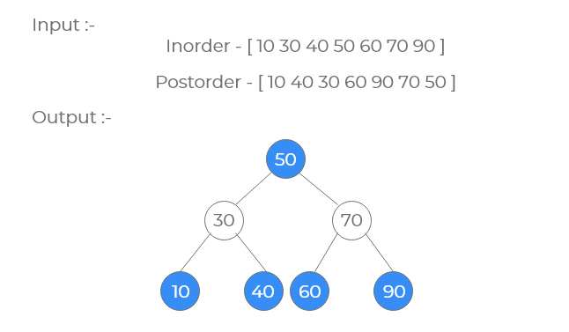
Try it on your own

Slide 26
ConSTRUCT binary tree FROM PREORDER AND POSTORDER

Slide 27
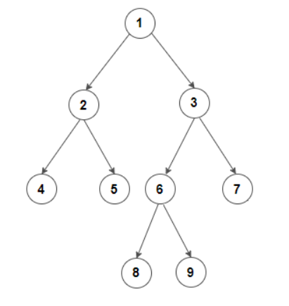
Given Preorder and Postorder construct Full Binary tree
Preorder
[Root, Left, Right]
1 | 2 | 4 | 5 | 3 | 6 | 8 | 9 | 7
Postorder
[Left, Right, Root]
4 | 5 | 2 | 8 | 9 | 6 | 7 | 3 | 1

Slide 28
STEP 1: Find root node
Root
Preorder
[Root, Left, Right]
1 | 2 | 4 | 5 | 3 | 6 | 8 | 9 | 7
Postorder
[Left, Right, Root]
4 | 5 | 2 | 8 | 9 | 6 | 7 | 3 | 1
Root

Slide 29
STEP 2: Find Left and Right subtree of the root node
Left
1
Preorder
[Root, Left, Right]
1 | 2 | 4 | 5 | 3 | 6 | 8 | 9 | 7
2,4,5
3,6,8,9,7
Postorder
[Left, Right, Root]
4 | 5 | 2 | 8 | 9 | 6 | 7 | 3 | 1
Right

Slide 30
STEP 3: Repeat the process on left subtree
Left
1
Preorder
[Root, Left, Right]
2 | 4 | 5
2
3,6,8,9,7
Postorder
[Left, Right, Root]
4 | 5 | 2
4
5
Right

Slide 31
STEP 4: Repeat the process on Right subtree
Left
1
Preorder
[Root, Left, Right]
3 | 6 | 8 | 9 | 7
3
2
Postorder
[Left, Right, Root]
8 | 9 | 6 | 7 | 3
7
4
5
6,8,9
Right

Slide 32
STEP 4: Repeat the process on Right subtree
Left
1
Preorder
[Root, Left, Right]
6 | 8 | 9
3
2
Postorder
[Left, Right, Root]
8 | 9 | 6
7
4
5
6
Right
8
9
Final Binary Tree

Slide 33
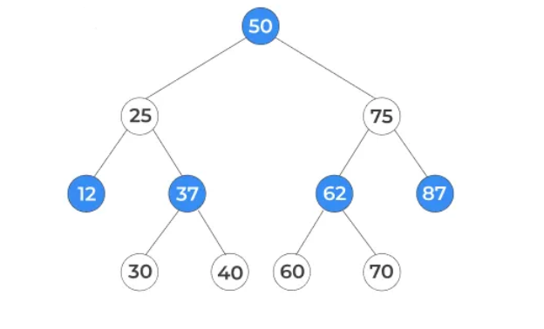
Try it on your own
Preorder: 50, 25, 12, 37, 30, 40, 75, 62, 60, 70, 87
Postorder: 12, 30, 40, 37, 25, 60, 70, 62, 87, 75, 50

